Slide 1
Devops tools

Slide 2

About Me
My name is Saurabh Kandhway . I have around 12 years of Experience into DevOps and QA Automation . I am currently working as a Test Lead in one of the Product based MNC .I have around 6+ years of teaching experience into all the tools and technologies used for Cloud. .I am ISTQB , AZ 900 Microsoft Azure Fundamentals, AWS basic cloud practioner,GCP leader Foundational, Pcloudy (Cloud based environment for Testing) certified testing professional . I am a certified Simplilearn high Engagement trainer.

Slide 3
What are devOps tools
DevOps tools are software applications that help automate, integrate, and manage the different stages of the software development and IT operations process.
They are used to:
Improve collaboration between development (Dev) and operations (Ops) teams.
Automate repetitive tasks like building, testing, deployment, and monitoring.
Ensure faster, more reliable delivery of software.
Enable practices like Continuous Integration (CI), Continuous Delivery (CD), and Infrastructure as Code (IaC).

Slide 4
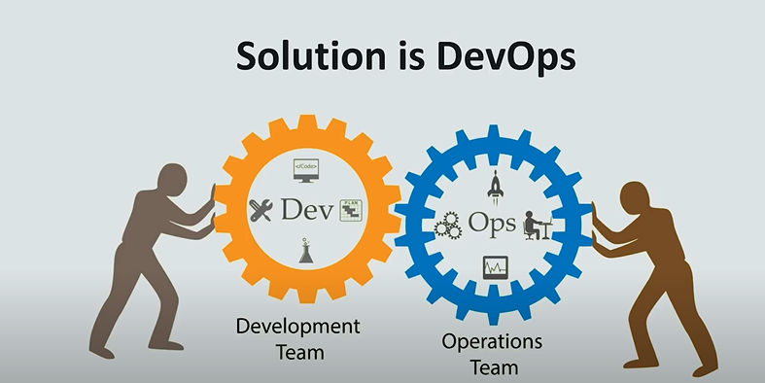
Why devops

Slide 5
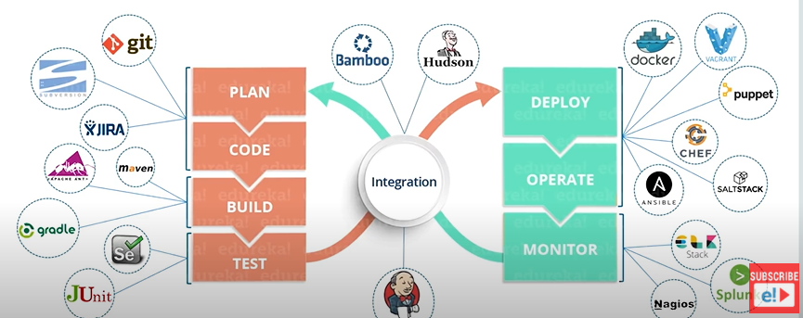
How devops work

Slide 6
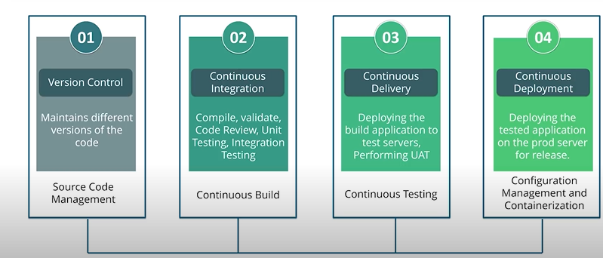
Devops stages

Slide 7
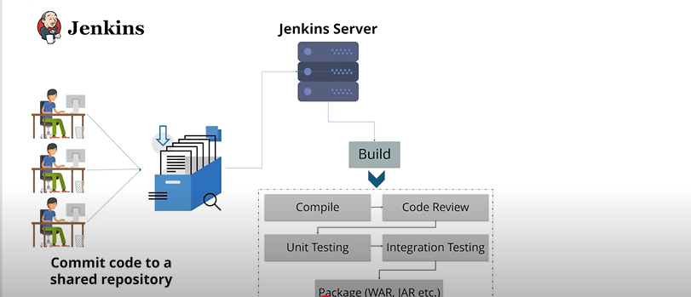
Continuous integration

Slide 9
What will happen if not using devops
Slower Delivery Cycles
Without DevOps automation (CI/CD pipelines, automated testing, infrastructure as code), releases happen less frequently.
Deployments may take days or weeks instead of minutes or hours.
Any urgent bug fix or feature takes longer to reach production.
More Manual Work & Errors
Builds, deployments, and configurations are often done manually—easy to mess up.
“It worked on my machine” problems increase because environments are not consistent.
Rollbacks and hotfixes become stressful and error-prone.

Slide 10
What will happen if not using devops
Difficulty Scaling & Innovating
Infrastructure scaling is manual and slow without cloud automation or IaC.
Adapting to market changes or customer feedback takes longer.
Competitors using DevOps can outpace your delivery speed.
Security as an Afterthought
Without DevSecOps, security checks happen late in the process.
Vulnerabilities may remain undiscovered until production.
Compliance audits become painful and time-consuming.

Slide 11
Devops tools
Category | Purpose | Examples
Planning & Collaboration | Manage projects, track issues, and enable team communication | Jira, Trello, Confluence, Slack, MS Teams
Source Code Management (SCM) | Store and version control code, enable collaboration | Git, GitHub, GitLab, Bitbucket
Continuous Integration (CI) | Automate code building and testing after every change | Jenkins, GitHub Actions, GitLab CI/CD, CircleCI
Configuration Management | Automate and manage infrastructure and environment setup | Ansible, Puppet, Chef, SaltStack
Containerization | Package applications into lightweight, portable units | Docker, Podman
Container Orchestration | Manage and scale containerized applications | Kubernetes, OpenShift, Docker Swarm
Continuous Delivery/Deployment (CD) | Automate software releases to staging/production environments | Argo CD, Spinnaker, Octopus Deploy
Monitoring & Logging | Track performance, collect logs, and analyze issues | Prometheus, Grafana, ELK Stack, Splunk, Datadog
Security & DevSecOps | Integrate security checks and vulnerability scanning into DevOps pipelines | SonarQube, Snyk, Aqua Security, HashiCorp Vault

Slide 12
Planning and collaboration
Purpose: Help teams organize work, manage tasks, track progress, and share information. Why it matters: DevOps is not just about tools; it’s about collaboration. These tools keep developers, testers, and operations aligned.
Examples:
Jira – Used for Agile project management, sprint planning, bug tracking.
Trello – Simple Kanban-style boards for task management.
Confluence – Documentation and knowledge base.
Slack / Microsoft Teams – Communication with integrations to CI/CD, monitoring, etc.
Key Benefit: Everyone knows what’s happening, who’s doing what, and when it’s due.

Slide 13
Source Code Management (SCM)
Purpose: Store, track, and manage changes to code over time. Why it matters: Prevents overwriting each other’s work, enables rollback, and supports collaboration.
Examples:
Git – Distributed version control system.
GitHub – Git hosting + code reviews + collaboration.
GitLab – Git hosting + built-in CI/CD.
Bitbucket – Git hosting with Jira integration.
Key Benefit: Developers work on different parts of the project without conflict and can merge changes safely.

Slide 14
Continuous Integration (CI)
Purpose: Automatically build and test code whenever changes are pushed. Why it matters: Detects bugs early, avoids "integration hell."
Examples:
Jenkins – Popular open-source CI server with plugins.
GitHub Actions – GitHub-native CI/CD automation.
GitLab CI/CD – Integrated with GitLab repositories.
CircleCI – Cloud-based CI/CD service.
Key Benefit: Code is always in a working, tested, and deployable state.

Slide 15
Configuration Management
Purpose: Automate server configuration and maintain consistency across environments. Why it matters: Manual setup is error-prone; automation ensures reliability and reproducibility.
Examples:
Ansible – Agentless automation tool for configuration and deployments.
Puppet – Manages infrastructure using a declarative language.
Chef – Infrastructure automation using “recipes” (code).
SaltStack – Event-driven automation and orchestration.
Key Benefit: No more “it works on my machine” — environments are consistent everywhere.

Slide 16
Containerization
Purpose: Package applications and dependencies into portable, lightweight containers. Why it matters: Containers run anywhere without worrying about OS differences.
Examples:
Docker – Most popular container platform.
Podman – Docker alternative without a central daemon.
Key Benefit: Applications are portable and easy to deploy in any environment.

Slide 17
Container Orchestration
Purpose: Manage, scale, and monitor large numbers of containers automatically. Why it matters: Manually handling hundreds of containers is impossible; orchestration handles deployment, scaling, and networking.
Examples:
Kubernetes – Most widely used container orchestrator.
OpenShift – Red Hat’s enterprise Kubernetes platform.
Docker Swarm – Simpler container orchestration for Docker.
Key Benefit: Reliable, automated management of complex containerized systems.

Slide 18
Continuous Delivery/Deployment (CD)
Purpose: Automate release processes to deliver updates faster and more frequently. Why it matters: Shortens time from code commit to production deployment.
Examples:
Argo CD – GitOps-based Kubernetes deployment tool.
Spinnaker – Multi-cloud continuous delivery.
Octopus Deploy – Automated release management.
Key Benefit: Frequent, low-risk releases with minimal downtime.

Slide 19
Monitoring & Logging
Purpose: Observe application performance, detect issues, and analyze logs. Why it matters: Helps fix problems before users notice them and supports root-cause analysis.
Examples:
Prometheus – Metrics collection and alerting.
Grafana – Visualization dashboards for metrics.
ELK Stack (Elasticsearch, Logstash, Kibana) – Log collection and analysis.
Splunk – Powerful log and event analysis.
Datadog / New Relic – Application performance monitoring (APM).
Key Benefit: Faster troubleshooting, better system reliability.

Slide 20
Security & DevSecOps
Purpose: Integrate security checks early in the DevOps pipeline (shift-left security). Why it matters: Prevent vulnerabilities before they reach production.
Examples:
SonarQube – Code quality and security scanning.
Snyk – Detects vulnerabilities in dependencies.
Aqua Security – Container and cloud-native security.
HashiCorp Vault – Manages secrets, keys, and credentials.
Key Benefit: Security becomes part of development instead of an afterthought.

Slide 21
Git – Version Control System
• Category: Source Code Management (SCM)
• Purpose: Track changes in source code, support branching/merging, enable collaboration among developers.
• How it works: Git maintains a full local repository for each user (distributed VCS), meaning you can commit, branch, and view history offline, then sync with a remote repo.
• Key Features:
Branching and merging without affecting main code until merged.
Commit history for rollback and auditing.
Distributed — no single point of failure.
• Pros: ✅ Fast branching/merging ✅ Offline work possible ✅ Widely supported by all CI/CD tools

Slide 22
GitHub / GitLab / Bitbucket – Code Hosting Platforms
Category: Repository Hosting + Collaboration
Purpose: Host Git repositories online with added features like Pull Requests (PR), code reviews, and integrated CI/CD pipelines.
Key Features:
Issues & bug tracking
Pull/Merge request workflows
Branch protection rules
Built-in pipeline automation
Differences:
GitHub: Most popular, huge open-source community, integrates with GitHub Actions for CI/CD.
GitLab: Self-hostable, strong built-in DevOps toolchain.
Bitbucket: Atlassian ecosystem integration (Jira, Confluence).
Typical Use in DevOps: After coding in Git, developers push to these platforms for review and pipeline triggering.

Slide 23
Jenkins – Automation Server
• Category: Continuous Integration / Continuous Delivery (CI/CD)
• Purpose: Automates building, testing, and deploying code.
• How it works: Jenkins uses “pipelines” (scripted in Groovy or YAML) to define steps for build, test, and deploy.
• Key Features:
1,800+ plugins for almost any tool.
Supports distributed builds across multiple servers.
Can trigger jobs via Git commits, schedules, or APIs.
• Pros: ✅ Extremely flexible ✅ Huge plugin ecosystem ✅ Works with any tech stack

Slide 24
Ansible – Configuration Management Tool
• Category: Infrastructure Automation
• Purpose: Automates server setup, configuration, and deployment of applications.
• How it works: Uses YAML playbooks to define desired server states. Agentless — runs over SSH.
• Key Features:
No need to install agents on target machines.
Idempotent — re-running doesn’t break configs.
Supports dynamic inventory for cloud systems.
• Pros: ✅ Easy to learn (human-readable syntax) ✅ Works for both cloud & on-premises

Slide 25
Docker (Containerization)
What it is: A platform for building, shipping, and running applications in lightweight containers. Key Features:
Consistent environments across dev, test, and prod
Docker Hub for sharing images
Easy scaling and deployment Best for: Eliminating “it works on my machine” problems.

Slide 26
Kubernetes (Container Orchestration)
What it is: An orchestration system for managing containerized applications at scale. Key Features:
Automatic scaling and self-healing
Load balancing and service discovery
Rolling updates and rollbacks Best for: Managing microservices in production environments.

Slide 27
Terraform (Infrastructure as Code - IaC)
What it is: An open-source IaC tool for provisioning infrastructure. Key Features:
Declarative configuration syntax
Works with AWS, Azure, GCP, and more
State management for tracking infrastructure changes Best for: Automating infrastructure provisioning across multiple cloud providers.

Slide 28
Prometheus (Monitoring)
What it is: An open-source monitoring and alerting system. Key Features:
Time-series data storage
Powerful query language (PromQL)
Integration with Grafana for dashboards Best for: Monitoring metrics in Kubernetes and microservices environments.

Slide 29
Grafana (Visualization)
What it is: An analytics and visualization tool. Key Features:
Beautiful interactive dashboards
Supports many data sources (Prometheus, Elasticsearch, InfluxDB, etc.)
Alerting capabilities Best for: Turning raw metrics into understandable visuals.

Slide 30
ELK Stack (Elasticsearch, Logstash, Kibana) (Logging)
What it is: A logging and analytics stack for centralized log management. Key Features:
Elasticsearch: search & indexing engine
Logstash: log pipeline processor
Kibana: visualization and analysis Best for: Troubleshooting, security auditing, and log analysis.

Slide 31
Splunk (Enterprise Monitoring & Logging)
What it is: Paid, enterprise-grade platform for searching, monitoring, and analyzing data. Key Features:
Real-time insights
Machine learning integration
Scalable log analytics Best for: Large-scale enterprise log and data analysis.

Slide 32
SonarQube (Code Quality & Security)
What it is: Static code analysis tool for detecting bugs, vulnerabilities, and code smells. Key Features:
Multi-language support
CI/CD integration
Quality gates for release control Best for: Enforcing code quality standards automatically.

Slide 33
Selenium / Cypress (Test Automation)
What it is: Tools for automating UI and browser testing. Key Features:
Selenium: multiple browsers and languages
Cypress: faster, developer-friendly, built for modern web apps Best for: Automated functional testing in CI/CD pipelines.

